Slide 1
How am I going to register for my courses?
Grinnell College uses a very strange but stunningly successful system to get you quickly registered for classes this semester
You will never do this again. The other 7 semesters you are here you will use our online course registration system.
The card…

Slide 2
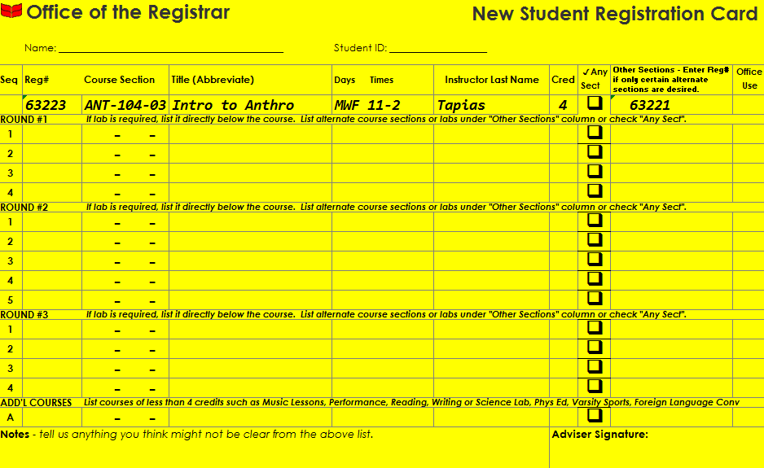
New Student Registration:
REGISTRATION CARD

Slide 3
COURSE REGISTRATION TIMELINE
EVENT | WHO | DATE(S)
New Student Advising | Advisers Students | Sunday, Aug. 21- Tuesday, Aug. 23
Deadline to submit completed and signed New Student Registration Card & Arrival Confirmation to Registrar’s Office | Students | 3:45p.m., Tuesday, Aug. 23
First Year Student Registration | Registrar’s Office | Evening of Tuesday, Aug. 23- Morning of Wednesday, Aug. 24
Course Schedules Posted | Registrar’s Office | By 2:00p.m., Wednesday, Aug. 24
Harris Center Registration Forum | Advisers Students Registrar’s Office | 3:00p.m., Wednesday, Aug. 24
Start of Term! Add/Drop Period Begins | Advisers Students Registrar’s Office | Thursday, Aug. 25
Last Day to Add or Drop a Class | Advisers Students Registrar’s Office | Friday, Sept. 9

Slide 4
COURSE REGISTRATION TIMELINE
EVENT | WHO | DATE(S)
New Student Advising | Advisers Students | Sunday, Aug. 21- Tuesday, Aug. 23
Deadline to submit completed and signed New Student Registration Card & Arrival Confirmation to Registrar’s Office | Students | 3:45p.m., Tuesday, Aug. 23
First Year Student Registration | Registrar’s Office | Evening of Tuesday, Aug. 23- Morning of Wednesday, Aug. 24
Course Schedules Posted | Registrar’s Office | By 2:00p.m., Wednesday, Aug. 24
Harris Center Registration Forum | Advisers Students Registrar’s Office | 3:00p.m., Wednesday, Aug. 24
Start of Term! Add/Drop Period Begins | Advisers Students Registrar’s Office | Thursday, Aug. 25
Last Day to Add or Drop a Class | Advisers Students Registrar’s Office | Friday, Sept. 9
Remember, 3 “rounds” on the card

Slide 5
What the Registrar’s Office does after your card is turned in
Thoroughly shuffle all the registration cards. Randomized order.
Start with Line 1 in Round 1. If Line 1 course is not available, go to alternate course on Line 2. If Line 2 course in Round 1 is not available, go to alternate course on Line 3, etc.
Labs sections are registered in the same round as the accompanying Lecture section.
If none of student’s Round 1 courses are available, we will dip into Round 2.
Reverse stack of registration cards and repeat the process for Rounds 2 and 3.
If none of student’s Round 3 courses are available, we will check other courses on the student’s card to see if they fit into their schedule.
Add “Additional Courses”.

Slide 6
New Student Registration:
REGISTRATION CARD

Slide 7
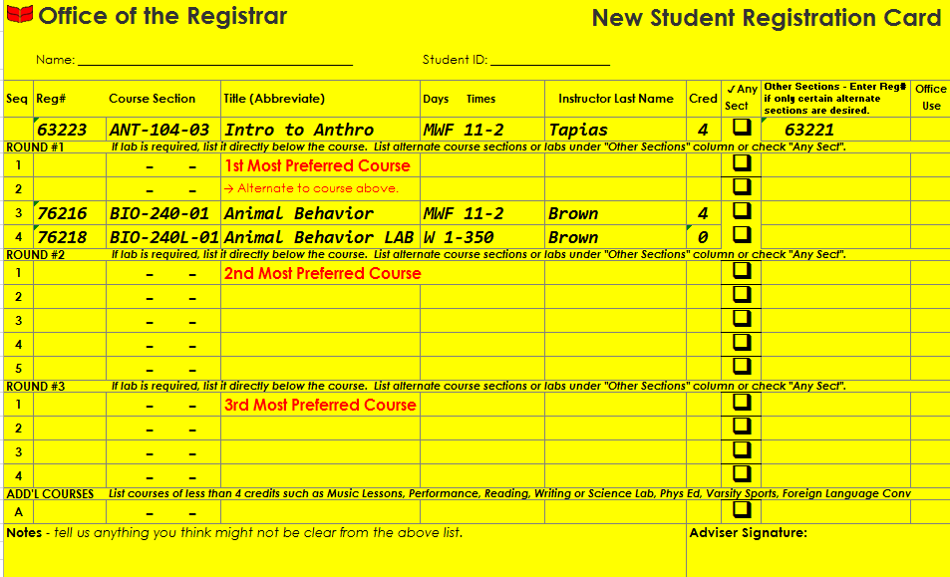
FILLING OUT THE CARD:
New Student Registration:
REGISTRATION CARD
1st line of each round = Top 3 preferred courses
Courses in 1st line of each round may not be at the same time.
2nd line of each round = Alternate to course on 1st line.
Use a separate line for a lab associated with the course on the line immediately above.
You are already registered for Tutorial. No need to list it.
When registration is done the student should have one class from each round.
Tip: Don’t get too specific! The “Any Section” checkbox is your friend!

Slide 8
New Student Registration:
REGISTRATION CARD

Slide 9
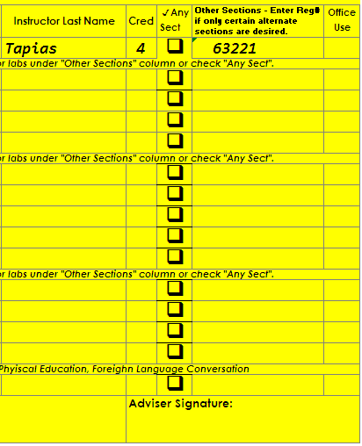
Orientation:
New Student Registration:
REGISTRATION CARD
Other Sections:
First choice section is full but student will accept the specific alternate section of the course listed here.
Any Sec(tion)
First choice section is full but student will accept any open section of this course.
If all specific section choices are full, the student will not be registered for the course.
Pro Tip: Select one column or the other, not both!

Slide 10
New Student Registration:
REGISTRATION CARD

Slide 11
FILLING OUT THE CARD:
New Student Registration:
REGISTRATION CARD
Additional Courses
Include Music lessons, PE classes, Foreign Lang Conversation, Reading Lab, etc.
Notes – Help the Registrar understand…
Why or who approved enrolling in class not on 1st Year List.
Why prereqs being waived if not Math or Language.
Remember to have me sign the card!

Slide 12
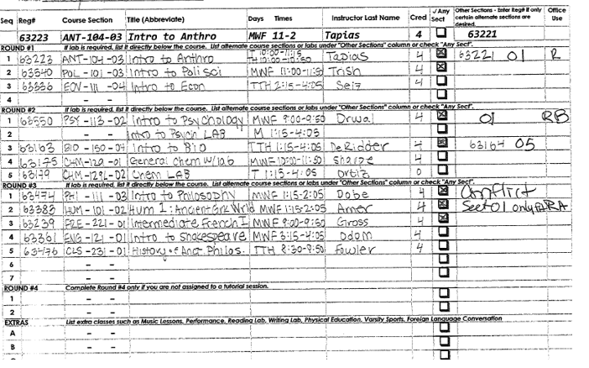
New Student Registration:
REGISTRATION CARD
FILLING OUT THE CARD:
Anatomy of a Great Card
Depth of choices – at least three course choices per round.
Each round represents a Division.
No time conflicts between top choices

Slide 13
We are about to talk course scheduling philosophy and specifics…
Before that, what questions do you have about the mechanics of filling out your card?

Slide 14
From the Grinnell College Catalog (p. 15)
“The following guidelines are helpful…during the first year.
The student should develop his or her command of written English, not only in the tutorial, but also in at least one other suitable course as well.
The student should develop his or her knowledge of mathematics, a foreign language, or both.
The student should take courses in each of the three main divisions of the curriculum – humanities, science, and social studies – and should take no more than two full courses in any one division in any semester.”

Slide 15
The three academic divisions
Social Studies
Anthropology
Economics
Education
History
Political Science
Sociology
Humanities
Art and Art Hist.
Classics
English
Languages
Music
Philosophy
Religious Studies
Theatre and Dance
Sciences
Biological Chemistry
Biology
Chemistry
Computer Science
Mathematics and Statistics
Physics
Psychology
Plus there’s GWSS and the concentrations!

Slide 16
Phi Beta Kappa Society requirements
Foreign Language: completion or proficiency through the third semester of a modern foreign language or the second semester of a classical foreign language (Latin, ancient Greek)
Math: Completion of MAT 131 or MAT 124. [AP Calc. credit counts]
General distribution: At least 12 credits in each academic division with coursework in at least 2 departments in each division.

Slide 17
To consider while you plan your courses
Continue something and try something new
Off campus study? How does this relate to taking language courses?
Try something that wasn’t available at your HS
Religious Studies, GWSS, Sociology, Art History, Music, Education, Antrho.
Paul’s “good” 4 year curriculum → A major, a concentration/clump, a bump or two, several singles
Don’t think every course you take has to contribute to your major
You can major in something without taking any required course 1st year

Slide 18
We are about to talk details about some specific types of courses…
Before that, what questions do you have about the college’s philosophy/expectations for your courses?

Slide 19
Info about specific types of courses
Language courses – ARH from 3 – 5 PM
Music theory exam – Bucksbaum room 152
Math – you should have a recommendation
Computer science – you should have a recommendation
The reading assessment (1 credit course available)
Writing lab course (1 credit course available)
Bio, Chem, Biochem, and/or premed typical first year sequence
BIO 150 and CHM 129, 1 each semester; MAT 131 (Calc. 1) sometime during the first year; if AP CHM credit take CHM 210 rather than CHM 129

Slide 20
Remember this?

Slide 21
Remember this?
Prioritize – the class you want the most goes in round 1, etc.
How do I game the system Paul?
Remember you have 7 more semesters at Grinnell after this one
What questions do you have?

Slide 22
Individual advising meeting
We’re going to come back to this schedule in a few minutes

Slide 23
What you need to do BEFORE we meet
Mostly, think about your courses for the first year
Come to our meeting with some ideas at a minimum
If you can take a stab at filling out your card, do that
Also aim to be able to tell me what you’d like to take during spring semester
Where are you in thinking about a potential major/ceoncentration?
I assure you most of you will change/refine this before you graduate
Do you think you’ll want to do Off Campus Study in your junior year?
My office is Steiner Hall, room 304 – very brief field trip
Procedure: Please let me know you’re waiting, then wait

Slide 24
Resources
Syllabus summary sheet – handed out
Online academic catalog
Online schedule of courses – through GrinnellShare or Academic Planning – I think
Departmental advising suggestions
Academic Planning in WebAdviser – lets find this for a student

Slide 25
Questions?
Don’t hesitate to email me when some come up

